Slide 1

ITC PROJECT (HTML WEBSITE)
Group members:
. Ahsan RAZA (GR)
. Naqi ASKARI
. MUHAMMAD Shayan

Slide 2

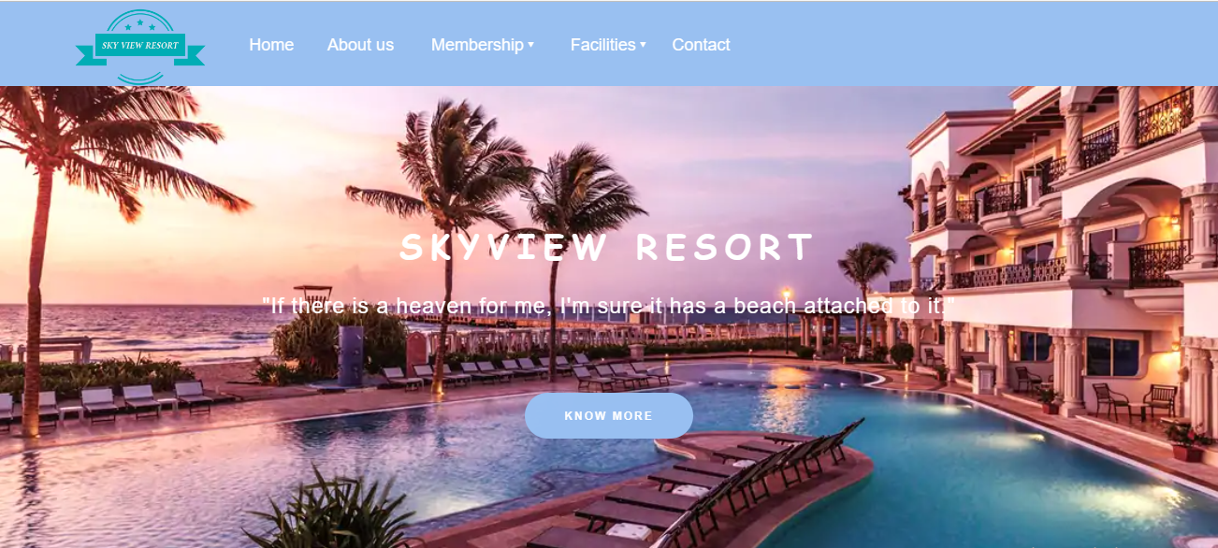
INTRODUCTION:
We have developed a hotel resort website (SKYVIEW RESORT).
This website can be used to view the resort virtually, to take details about the resort and booking it.
This website is made of HTML and CSS.

Slide 3
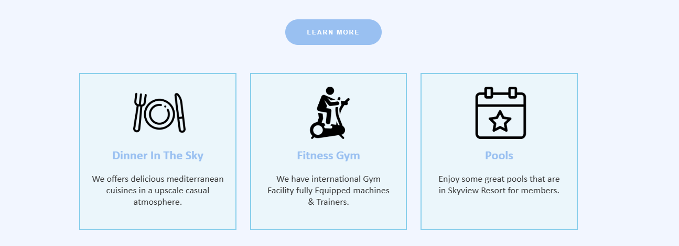
HOME:
The home page, User can interact by watching the view of breathtaking water slides, adventurous river rapids, a colossal wave pool, and a giant kid’s water castle.
There is tiny information regarding the facilities that resort have like (Fitness Gym, Pools).
There is the virtually view of the resort.

Slide 4
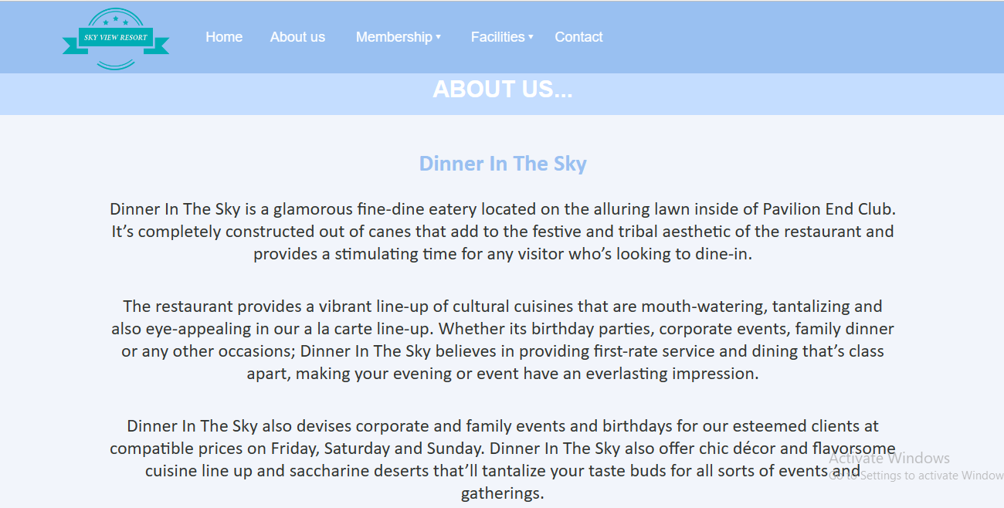
About:
The about us page, inform more about the location restaurant of the resort.
This tells the reader what the restaurant provides.
Tell about the events that can be arrange in the restaurant.

Slide 5
Membership:
This webpage is made for offering visitors our membership of the resort.
In this page we have given full details about the membership and have also given an online form, so that if any visitor in interested in availing it can immediately fill the form and get through the process.

Slide 6
Facilities:
This webpage is used to tell the visitors about the facilities we provide in the resort.
Example: Gym, pool etc

Slide 7
FACILITIES:

Slide 8
Contact:
This webpage is developed so that the visitors of the website doesn’t face any difficulty in contacting the resort management.

Slide 9
THANK YOU!!!

